Slide 1
Classes and Objects

Slide 2
Classes and Objects
Object − Objects have states and behaviors. Example: A dog has states - color, name, breed as well as behaviors – wagging the tail, barking, eating. An object is an instance of a class.
Class − A class can be defined as a template/blueprint that describes the behavior/state that the object of its type support.

Slide 3
Classes
A class is a group of objects which have common properties. It is a template or blueprint from which objects are created. It is a logical entity. It can't be physical. A class in Java can contain:
fields
methods
constructors
Blocks
class <class_name>{
field;
method;
}

Slide 4
Objects
It is a basic unit of Object Oriented Programming and represents the real life entities. A typical Java program creates many objects, which as you know, interact by invoking methods. An object consist of :
State : It is represented by attributes of an object. It also reflect the properties of an object.
Behavior : It is represented by methods of an object. It also reflects the response of an object with other objects.
Identity : It gives a unique name to an object and enables one object to interact with other objects.

Slide 5
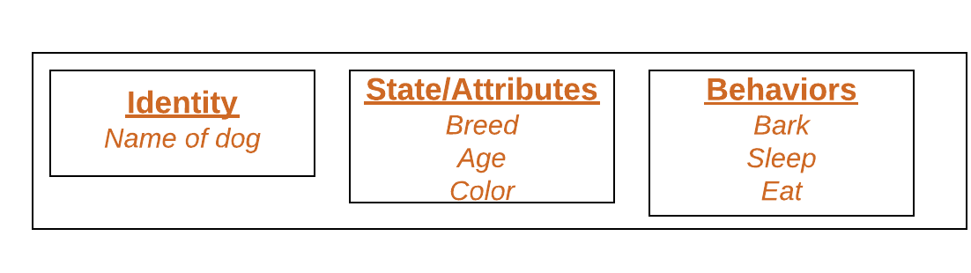
Objects

Slide 6
Objects
Objects correspond to things found in the real world.
For example, a graphics program may have objects such as “circle”, “square”, “menu”.
An online shopping system might have objects such as “shopping cart”, “customer”, and “product”
When an object of a class is created, the class is said to be instantiated.
All the instances share the attributes and the behavior of the class. But the values of those attributes, i.e. the state are unique for each object.
A single class may have any number of instances.

Slide 7
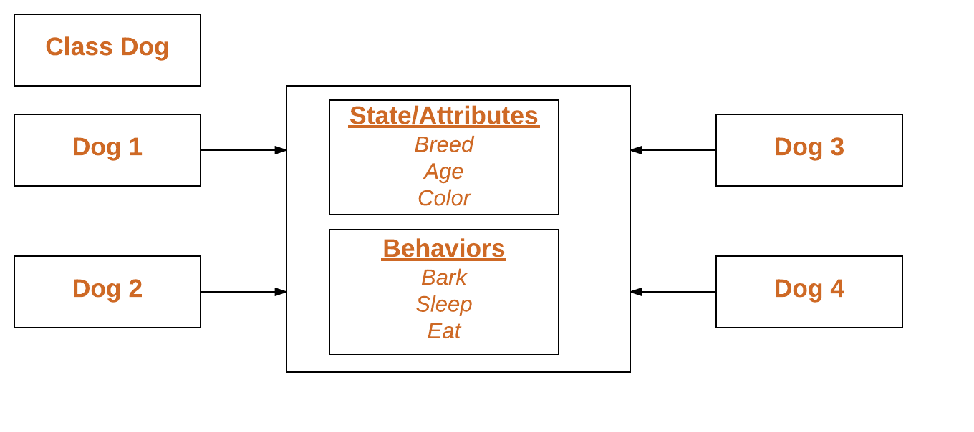
Objects

Slide 8
Example of a class
Public Class Account
{
Char Name[20];
int Account Type;
int Account Number;
float Balance
Input( );
Deposit (int x );
Withdraw (int x );
Enquire ( );
};
Account AC1;
Account AC2;
Account AC3;
AC1.Name
ox10
Arunkumar
AC1.Account Type
ox20
1
AC1.AccountNumber
ox22
1234567
AC1.Balance
ox24
10000.00
AC2.Name
ox40
arun
AC2.Account Type
ox60
2
AC2.AccountNumber
ox62
1234568
AC2.Balance
ox64
10000.00
AC3.Name
ox70
kumar
AC3.Account Type
ox90
3
AC3.AccountNumber
ox92
1234569
AC3.Balance
ox94
10000.00

Slide 9
Public Class Account
{
String Name; int Account Type;
int Account Number; float Balance;
public Account(String name, int act, int acn, float bal)
{
this.name=name
this.account type=act;
this.account number=acn;
this.balance=bal;
}
Public void deposit( int x)
{
balance +=x;
}
Public void withdraw(int x)
{
balance-=x;
}
public void enquire()
{
System.out.println(balance);
}
Public static void main(String args[ ])
{
Account AC1=new Account(“arun”,1, 1234, 100.00)
Account AC2=new Account(“ar”,2, 123, 100.00)
Account AC3=new Account(“arn”,2, 12, 100.00)
AC1.Deposit(500);
AC2.Deposit(500);
AC3.Deposit(500);
AC1.Withdraw(500);
AC2. Withdraw(400);
AC3. Withdraw(400);
}
}

Slide 10
Object and Class Example: main outside class
class Student{
int id;
String name;
}
class TestStudent1{
public static void main(String args[]){
Student s1=new Student();
System.out.println(s1.id);
System.out.println(s1.name);
}
}

Slide 11
Object and Class Example: Rectangle
class TestRectangle1{
public static void main(String args[]){
Rectangle r1=new Rectangle();
Rectangle r2=new Rectangle();
r1.insert(11,5);
r2.insert(3,15);
r1.calculateArea();
r2.calculateArea();
}
}
class Rectangle{
int length;
int width;
void insert(int l, int w){
length=l;
width=w;
}
void calculateArea()
{
System.out.println(length*width);
}
}

Slide 12
Anonymous object
class Calculation{
void fact(int n){
int fact=1;
for(int i=1;i<=n;i++){
fact=fact*i;
}
System.out.println("factorial is "+fact);
}
public static void main(String args[]){
new Calculation().fact(5);//calling method with anonymous object
}
}

Slide 13
Array of objects
Public Class Account
{
Char Name[20];
int Account Type;
int Account Number;
float Balance
Input( );
Deposit (int x );
Withdraw (int x );
Enquire ( );
};
Account AC[0];
Account AC[1];
Account AC[2];
AC[0].Name
ox10
Arunkumar
AC[0].Account Type
ox20
1
AC[0].AccountNumber
ox22
1234567
AC[0].Balance
ox24
10000.00
AC[1].Name
ox40
arun
AC[1].Account Type
ox60
2
AC[1].AccountNumber
ox62
1234568
AC[1].Balance
ox64
10000.00
AC[2].Name
ox70
kumar
AC[2].Account Type
ox90
3
AC[2].AccountNumber
ox92
1234569
AC[2].Balance
ox94
10000.00

Slide 14
Public Class Account
{
String Name; int Account Type;
int Account Number; float Balance;
public Account(String name, int act, int acn, float bal)
{
this.name=name
this.account type=act;
this.account number=acn;
this.balance=bal;
}
Public void deposit( int x)
{
balance +=x;
}
Public void withdraw(int x)
{
balance-=x;
}
public void enquire()
{
System.out.println(balance);
}
Public static void main(String args[ ])
{
Account AC[] =new Account[3]
AC[0] = new Account (“arun”,1, 1234, 100.00)
AC[1] =new Account(“ar”,2, 123, 100.00)
AC[2] =new Account(“arn”,2, 12, 100.00)
For(int i=0;i<3;i++)
AC[i].Deposit(500);
For(int i=0;i<3;i++)
AC[i]. Withdraw (500);
}
}

